Slide 1
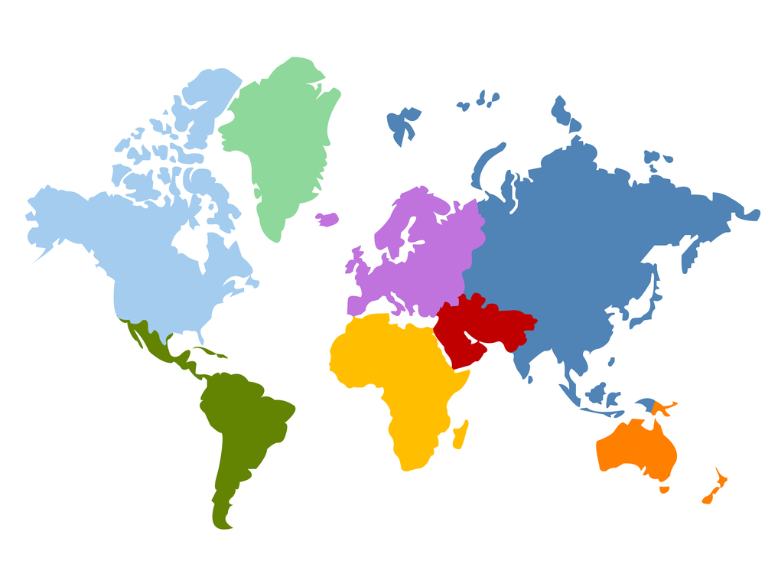
Part 1 Building Blocks
7 Micro Indicators:
Poverty Measurements
What nuances should we keep in mind when using indicators for policymaking?
What issues should we consider when measuring poverty?

Slide 2
How can we make progress in the development debates?
The next building block lectures are about how to use data to answer the policy debates:
Use economic models to highlight important economic processes/mechanisms
Focus on a macro diagnostic tool example: growth accounting.
A very classic example for the debate of how countries grow!
The math is basic enough that it’s a good start to learn R as well.
Track key development indicators to understand progress
Understand the nuances in creating a development indicator: poverty measurements.
Understand debates surrounding some of the indicators and why they arise.
Learn how to create indicators using household surveys (micro data). More R practice!
Use econometric methods to show whether programs work

Slide 3
Lecture Outline
Some Background
What are poverty measurements used for?
Poverty Measurements
2) Debates: Can statistics become political?
3) Nuances in Poverty Measurements
The consumption vs income debate
How should we adjust poverty measurements?

Slide 4
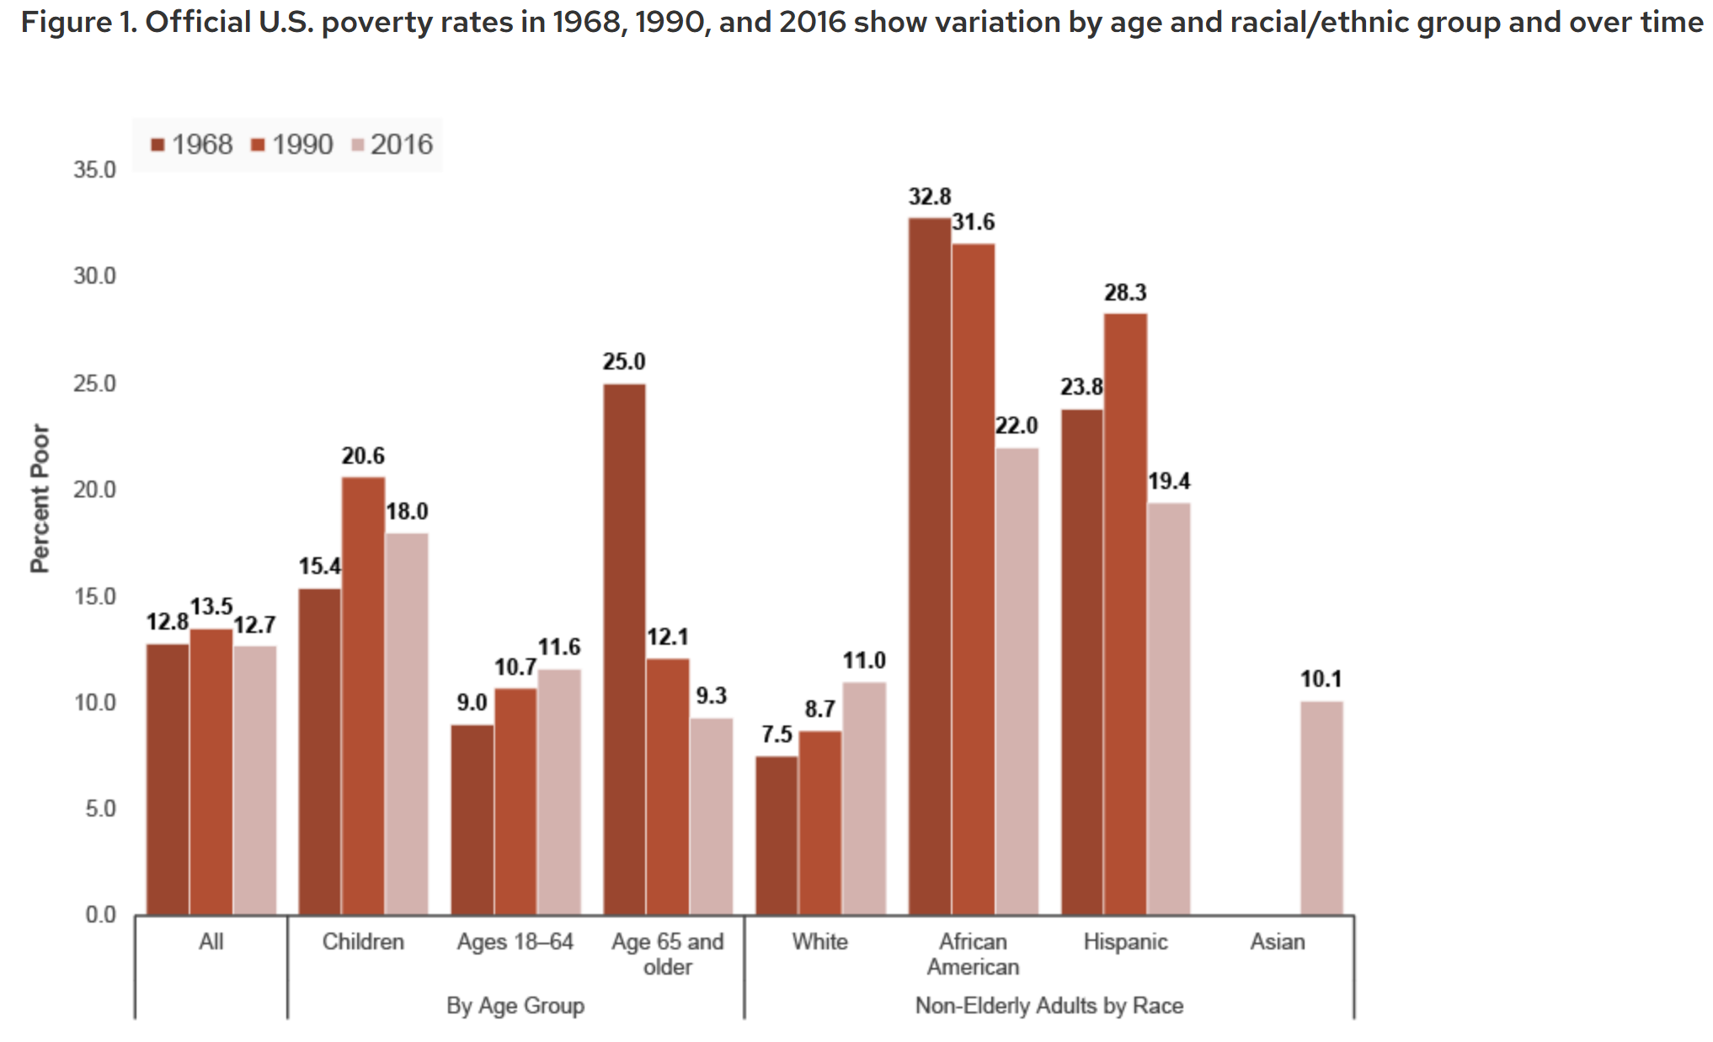
What are poverty measurements used for? (I)
1) Tracking poverty across time, regions, and various demographics
Source: IRP
Notes:
Poverty rate in the US is about 11.1% in 2023. SPM is 12.9%. Approximately 6 million people difference.
Poverty rate in Connecticut is about 10% in 2023.
Poverty rate in Hamden is about 9% in 2023.
Poverty rate in New Haven in about 25.3 is 2023.
Poverty rate in Yogyakarta is about 11.5% in 2023.
Poverty rate in Singapore is 0%.
It is hard to evaluate something without a point of comparison. That comparison does not necessarily mean a different city or group, but it can also be the same thing in time. It could be a baseline simulation that you are comparing to as well

Slide 5
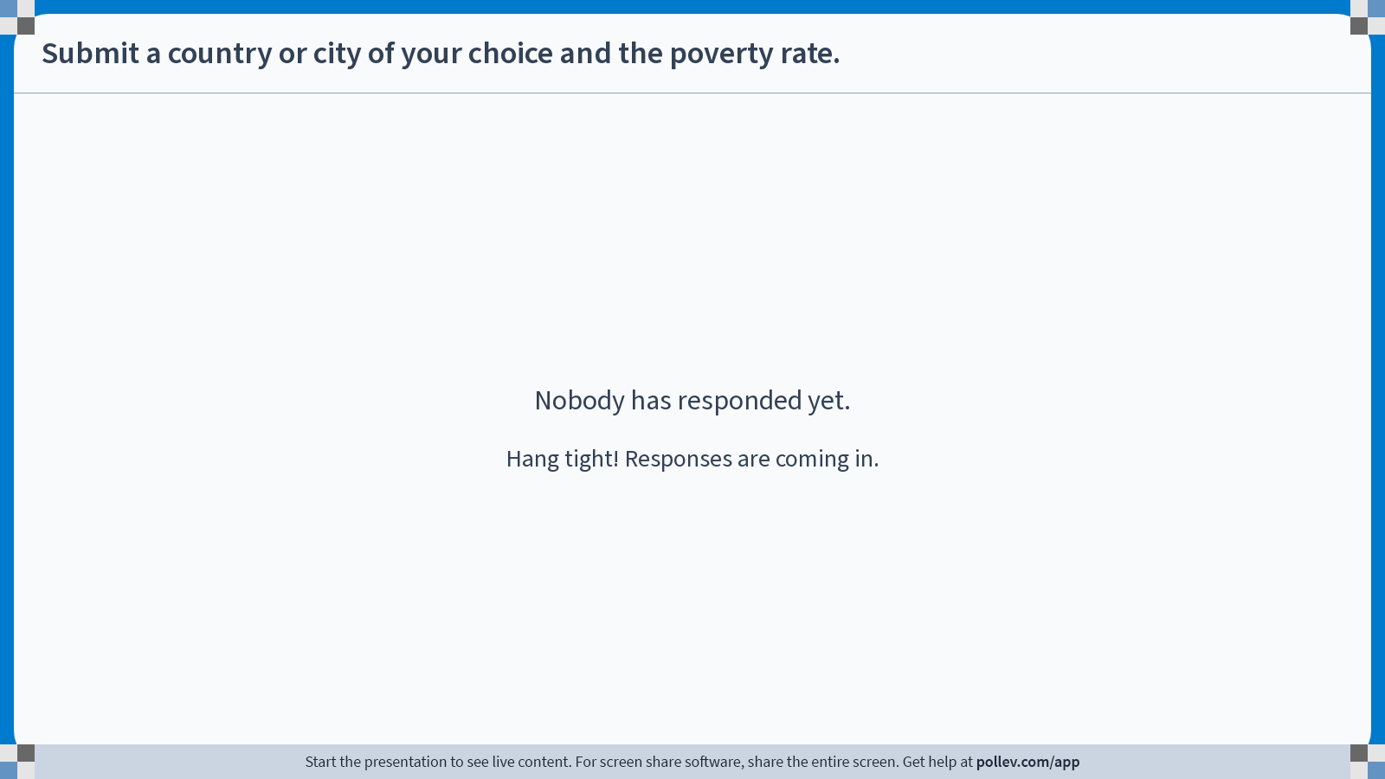
Poll Everywhere free text poll activity Activity Title: Submit a country or city of your choice and the poverty rate. Slide 6
Notes:
Do not modify the notes in this section to avoid tampering with the Poll Everywhere activity. More info at polleverywhere.com/support Submit a country or city of your choice and the poverty rate. https://www.polleverywhere.com/free_text_polls/SwuxEpZw0SP9sEFCurHxj

Slide 6
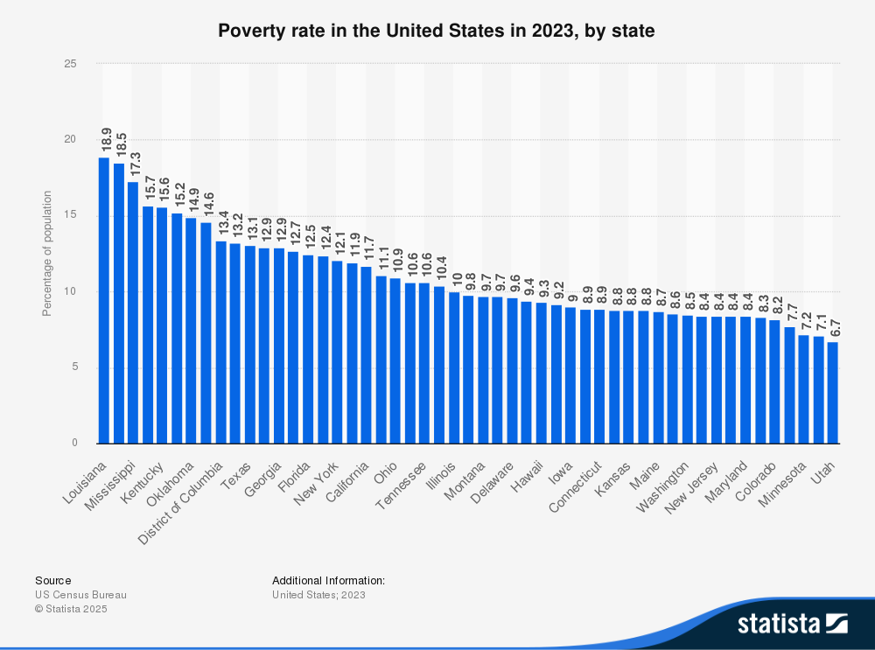

Slide 7
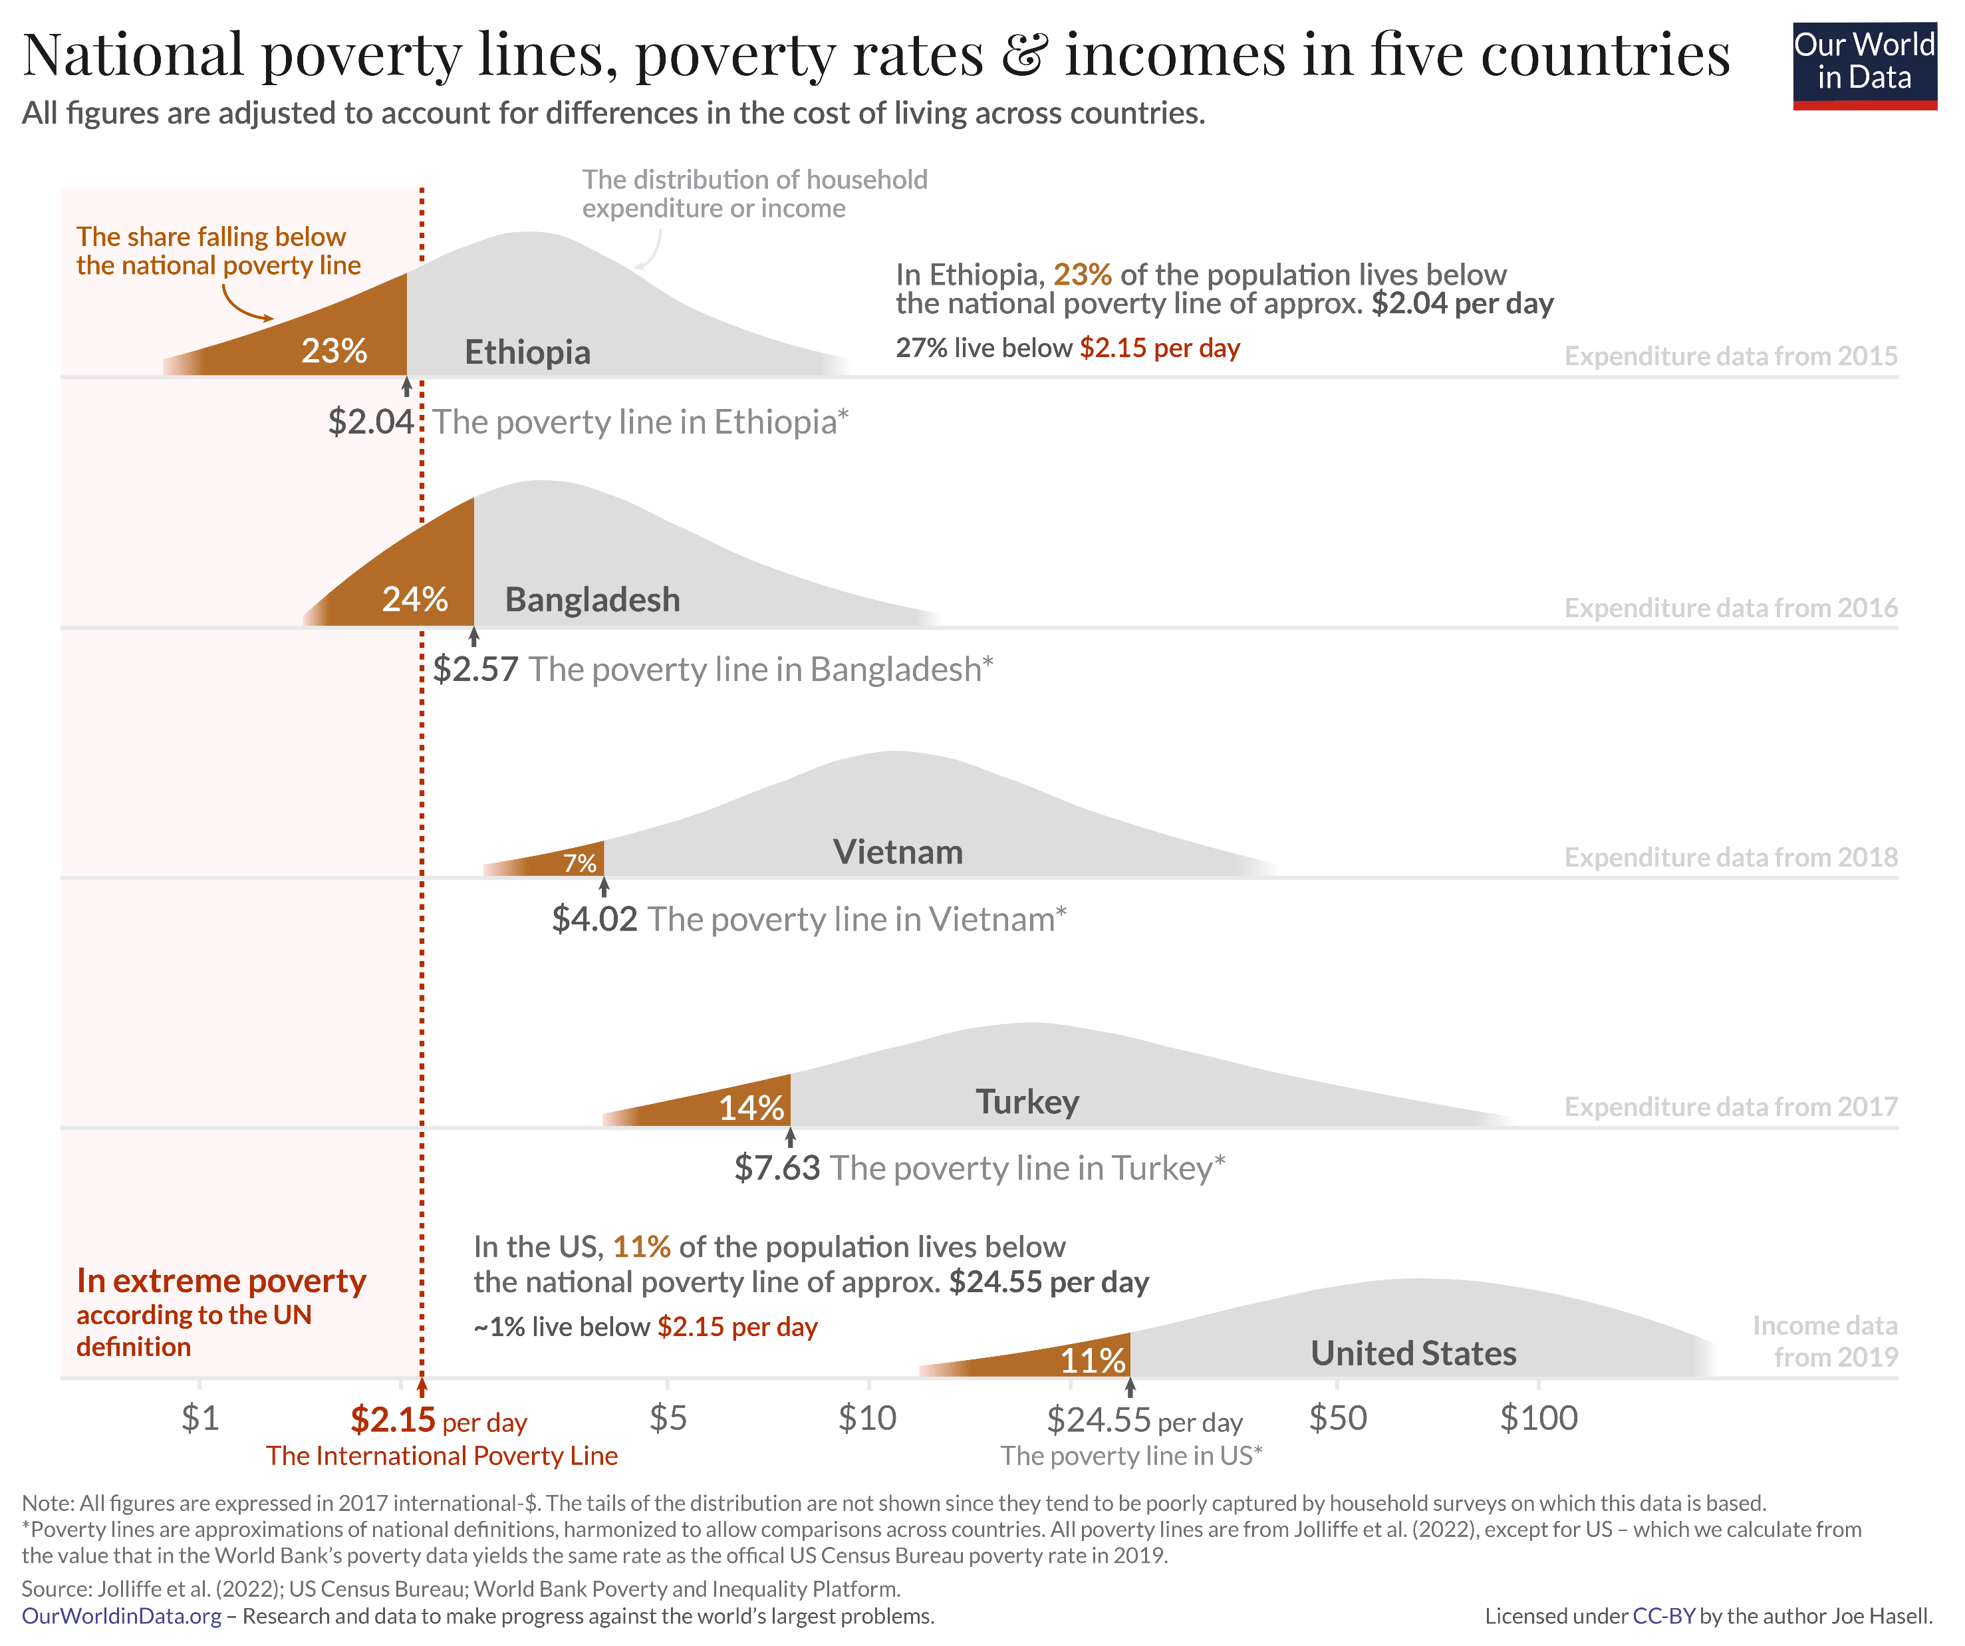
What are poverty measurements used for? (II)
Three things to keep in mind:
A statement about poverty depends on which line is chosen.
There is no agreement on which poverty line is best.
When comparing different regions or time periods, make sure definition of poverty is consistent.

Slide 8

What are poverty measurements used for? (III)
2) Targeting for Social Programs and Resource Allocation
“The Affordable Care Act of 2010 created the opportunity for states to expand Medicaid to cover nearly all low-income Americans under age 65. Eligibility for children was extended to at least 133% of the federal poverty level (FPL) in every state (most states cover children to higher income levels), and states were given the option to extend eligibility to adults with income at or below 133% of the FPL.”
“In Connecticut, individuals are categorically eligible for SNAP benefits if they meet a gross income limit of 185% of the Federal Poverty Level (FPL) and a net income limit of 100% FPL.” (Older Report, 2016)

Slide 9
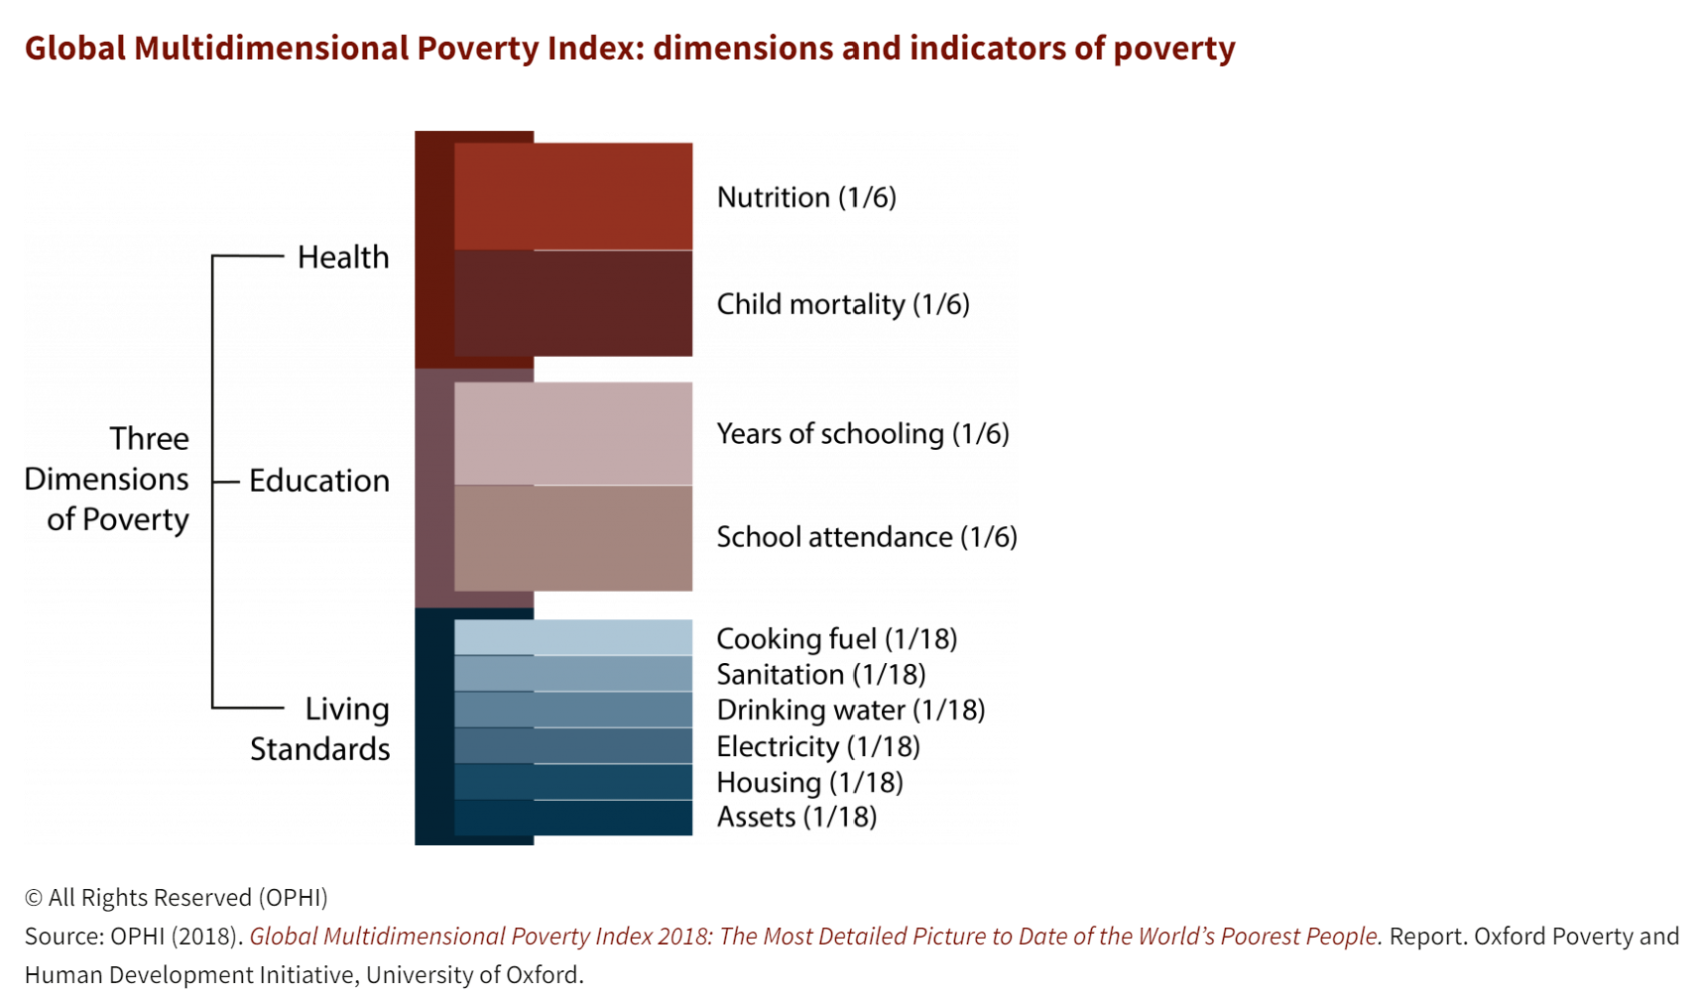
What are poverty measurements used for? (III)
Columbia has the System of Identification of Social Program Beneficiaries (SISBEN).
SISBEN Welfare Index tracks 24 variables across four dimensions: health, education, housing, and vulnerability.
Example use: Conditional cash transfer programs uses the index for eligibility.

Slide 10
Setting a poverty threshold
From Meyer and Sullivan (2011):
“the selection of a poverty cutoff is inherently arbitrary, so the finding that the poverty rate as calculated by the Supplemental Poverty Measure exceeds the official rate is a subjective or political decision, not a scientific one.”
Other types of poverty line:
Nutrition-Based Poverty Line: based on a calorie or food expenditure recommendation
International Poverty Line: set by the World Bank.
Relative Poverty Line
Example: “The average OECD relative poverty rate (i.e. the share of people living with less than half the median disposable income in their country) was 11.4% in 2021.”
Weakly Relative Poverty Line (proposed by Ravallion and Chen 2011)
Poverty line changes as the country’s GDP increases.
Notes:
Poverty rate in the US is about 11.1% in 2023. SPM is 12.9%. Approximately 6 million people difference.

Slide 11
Some Background
What are poverty measurements used for?
Poverty Measurements
2) Debates: Can statistics become political?
3) Nuances in Poverty Measurements
The consumption vs income debate
How should we adjust poverty measurements?

Slide 12
Can statistics be political?
Recall positive vs normative statements.
The statistics itself should be a positive statement (based on the underlying data, fact, or model). But we should recognize:
Statistics affect development stakeholders of interest (citizens, governments, and other development agencies). They can be used in making normative statements.
Statistics are always constructed with some definition or assumption in mind. Choices, preferences, and criticisms on these definitions and assumptions are also normative (based on value judgements).
It is thus important to understand the data and construction behind an indicator.

Slide 13

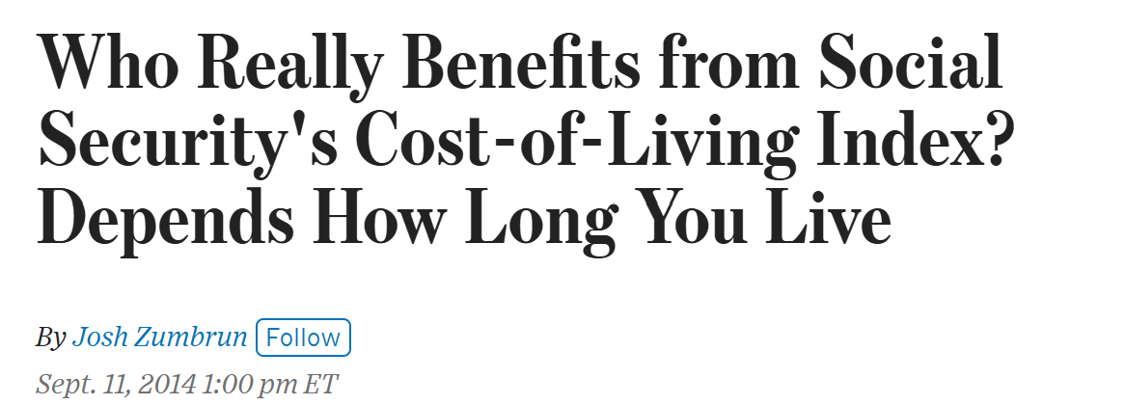
Why does it matter using CPI measurements that are 0.3 percentage points lower?
“But over time, this gap compounds. After 10 years, the gap is $36 a month. By year 20, the retiree under the Chained CPI is earning $90 less each month -- more than $1,000 less each year. Spread this across tens of millions of retirees, and the switch to the lower inflation index reduces Social Security expenditures by billions a year.”
“First, some background. Many proposals to balance the federal budget have included a provision that would switch the inflation index used to calculate Social Security. Instead of the current index known as the consumer price index for urban wage earners and clerical workers (or CPI-W), the government would instead use an index known as the Chained CPI.”
Link to article.

Slide 14
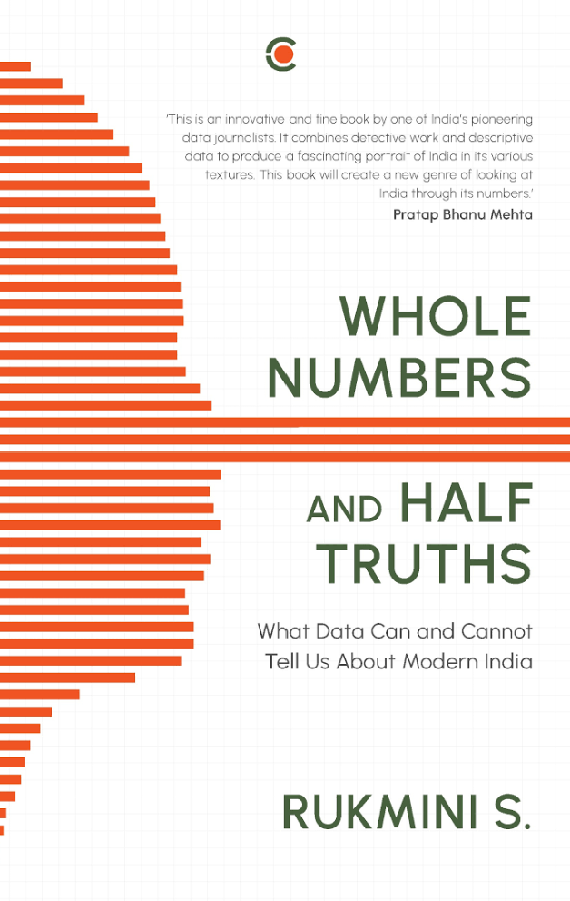
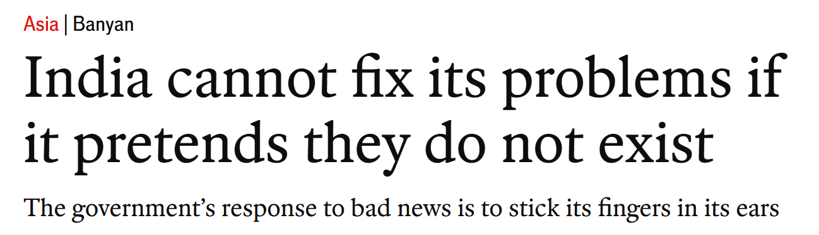
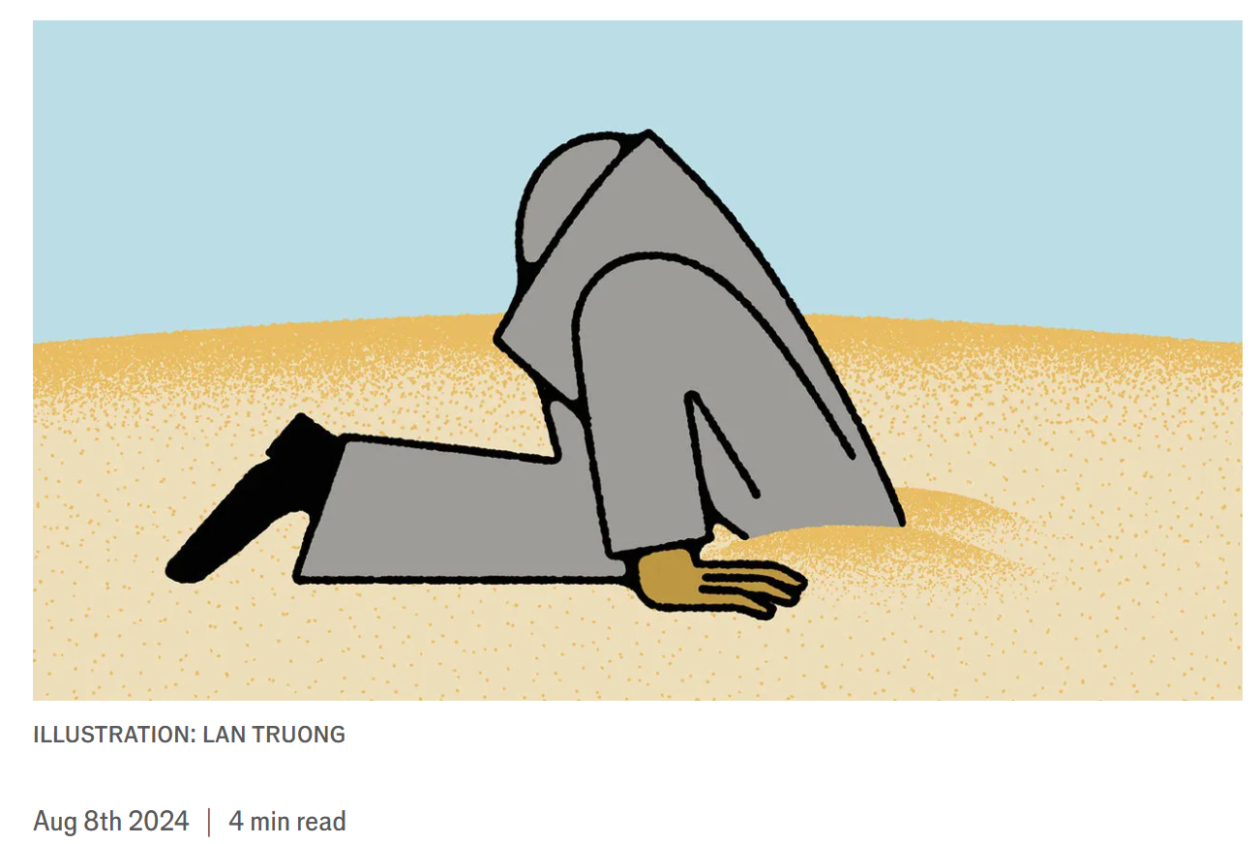
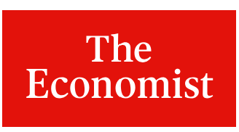
The Great Indian Poverty Debate
This debate was mentioned in your textbook reading.
“When the 1987-88 quinquennial (every five years) survey of the NSSO showed that poverty had reduced significantly since 1983-84, there was an outcry, and in response, the Planning Commission set up an expert group to review the methodology for estimating poverty.” – Rukmini S.
More information on debate here (Deaton 2005).
Similar issues are still seen today!
The 2017 – 2019 Consumption Survey Controversy
“The leaked 2017-18 data showed that real consumption expenditure had declined by 10 per cent per annum in rural areas and increased marginally by 2 per cent per annum in urban areas…” Rukmini S.

Slide 15
Some Background
What are poverty measurements used for?
Poverty Measurements
2) Debates: Can statistics become political?
3) Nuances in Poverty Measurements
The consumption vs income debate
How should we adjust poverty measurements?

Slide 16
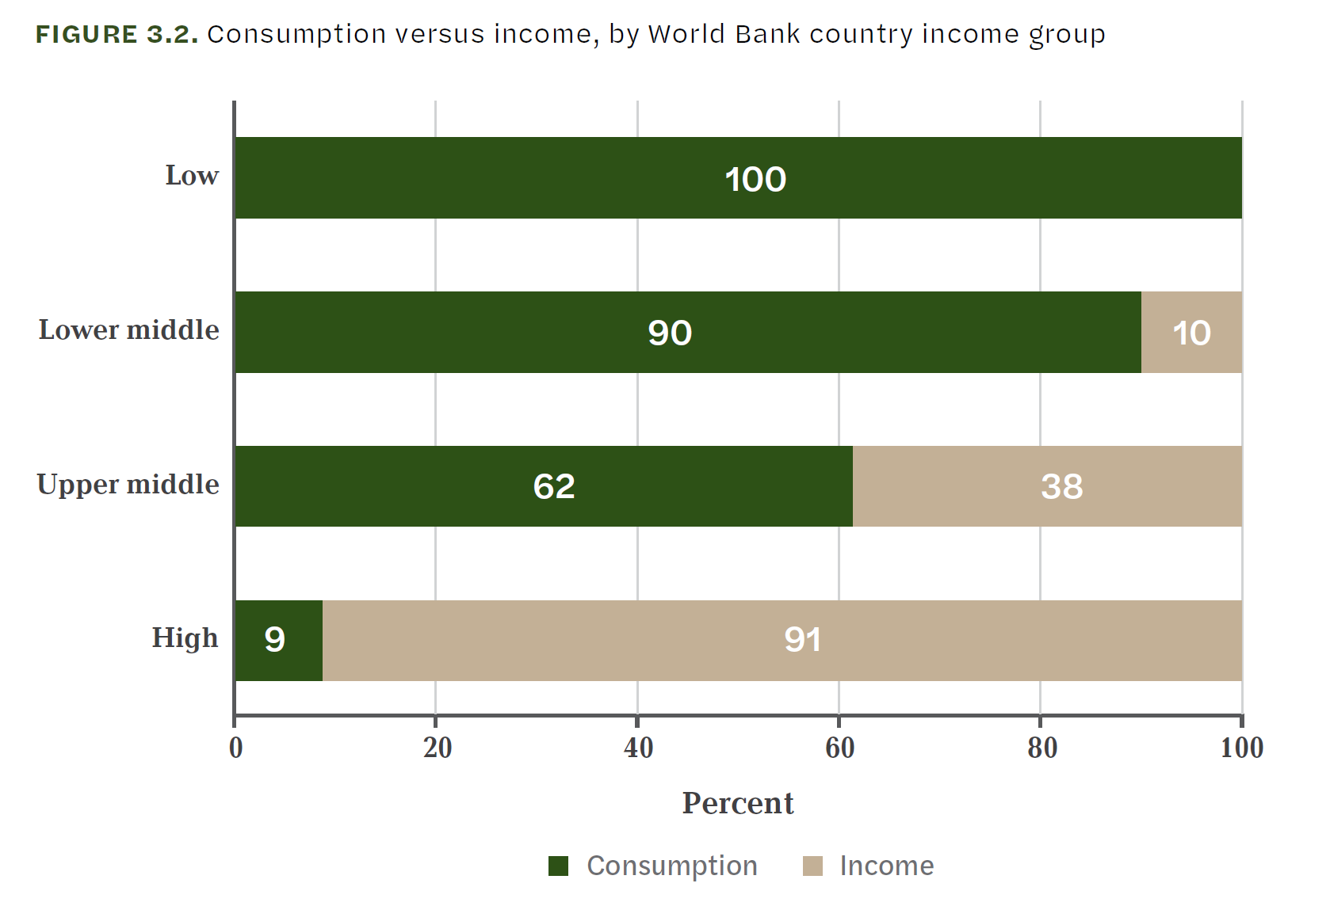
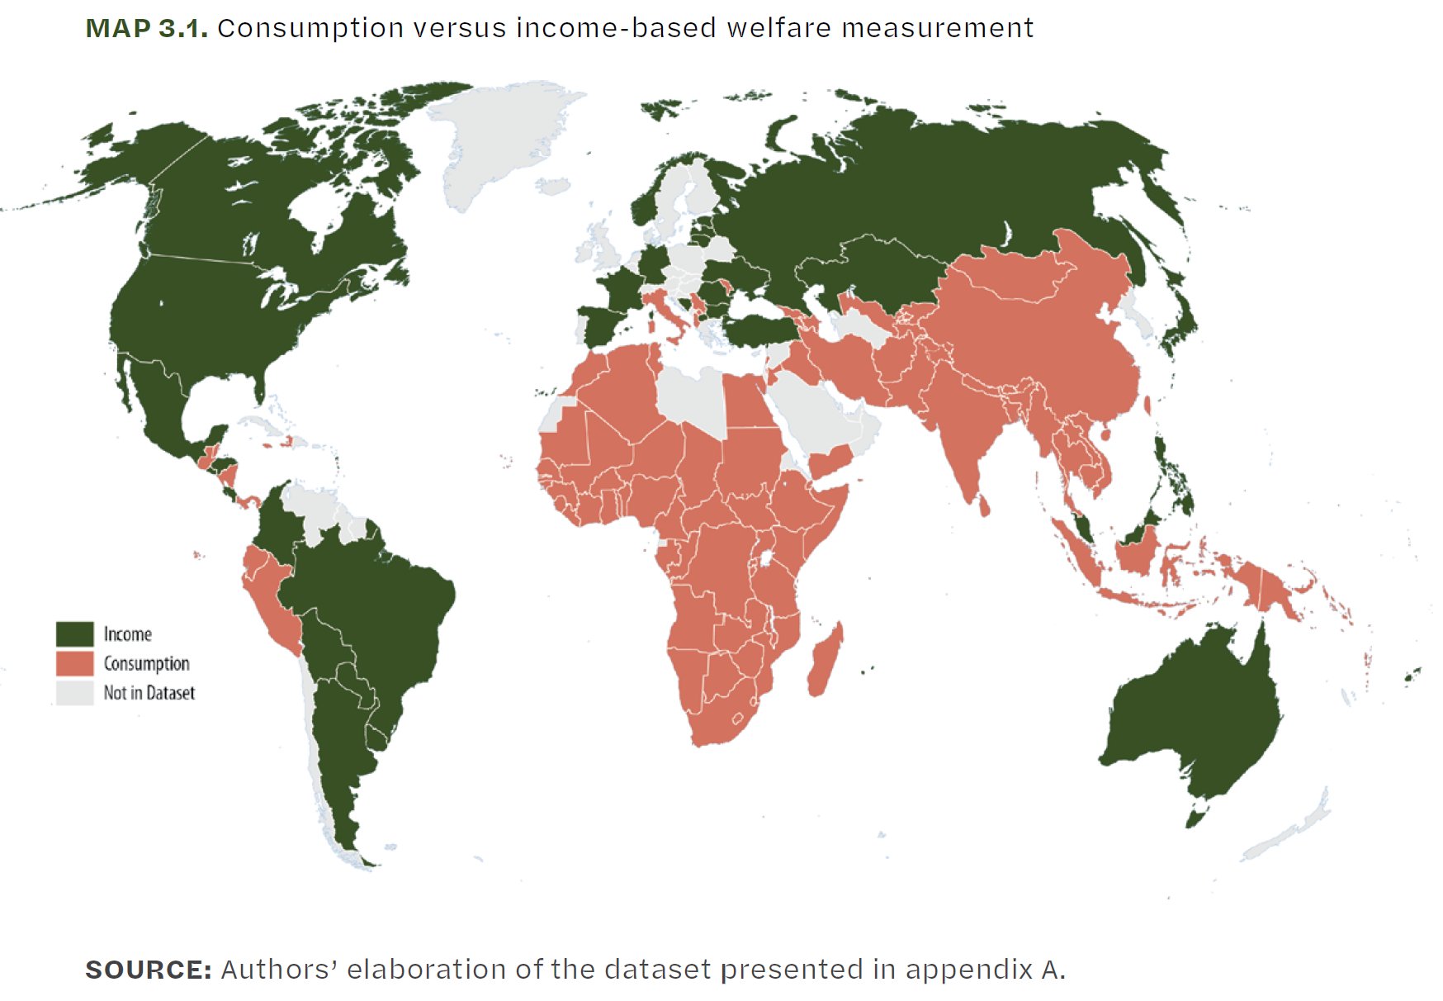
The Consumption vs Income Debate
Many nuances exist when creating a measurement.
There is an interesting debate on which measure to focus on for measuring welfare, and by extension inequality.
Mancini & Vecchi (2022)

Slide 17
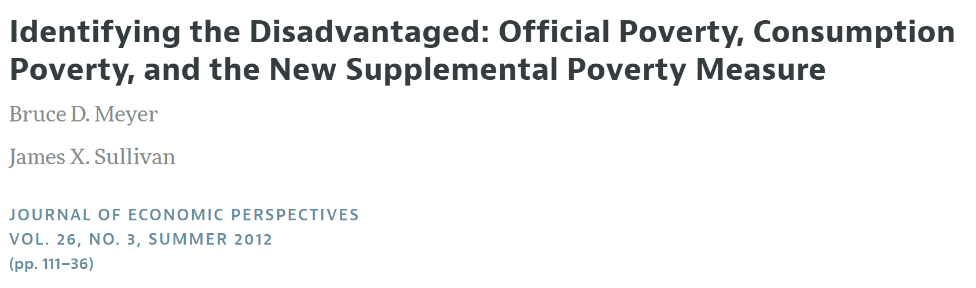
Does it matter which one you choose? Impact on targeting
$⇒$ Let’s look at a paper by Mayer and Sullivan (2012).
“Few economic indicators are more closely watched or more important for policy than the official poverty rate.”

Slide 18
How is a single-dimensional measure constructed?
Several issues to think about:
How should we define the resources available to people?
Consumption vs income debate lies.
What is the time-period of measurement?
What is the resource sharing unit?
Household threshold or individual threshold?
Where should the threshold be drawn?
How should the measure be adjusted? Adjusted for what?

Slide 19
Three Different Poverty Measures
The Official Poverty Measure | The Supplemental Poverty Measure | Consumption-Based Poverty Measure
Use pretax income as measure of resource Time period is one year Original threshold based on cost of a food plan Adjusted only for inflation using CPI for all urban consumer. | Income + tax credits + other benefits – tax liabilities and other expenses (out-of-pocket medical, child support, etc.) Household unit includes cohabitors, not just family members. Threshold is determined based on expenditure data for food, clothing, shelter, and utilities. Adjust for geographic variation in cost if living (using rent). | Better capture standard of living for those who smooth consumption Individuals have different levels of savings and wealth accumulations Other insurance from social program that can be used for consumption

Slide 20
Three Different Poverty Measures
The Official Poverty Measure | The Supplemental Poverty Measure | Consumption-Based Poverty Measure
Use pretax income as measure of resource Time period is one year Original threshold based on cost of a food plan Adjusted only for inflation using CPI for all urban consumer. | Income + tax credits + other benefits – tax liabilities and other expenses (out-of-pocket medical, child support, etc.) Household unit includes cohabitors, not just family members. Threshold is determined based on expenditure data for food, clothing, shelter, and utilities. Adjust for geographic variation in cost of living (using rent). | Better capture standard of living for those who smooth consumption Individuals have different levels of savings and wealth accumulations Other insurance from social program that can be used for consumption

Slide 21
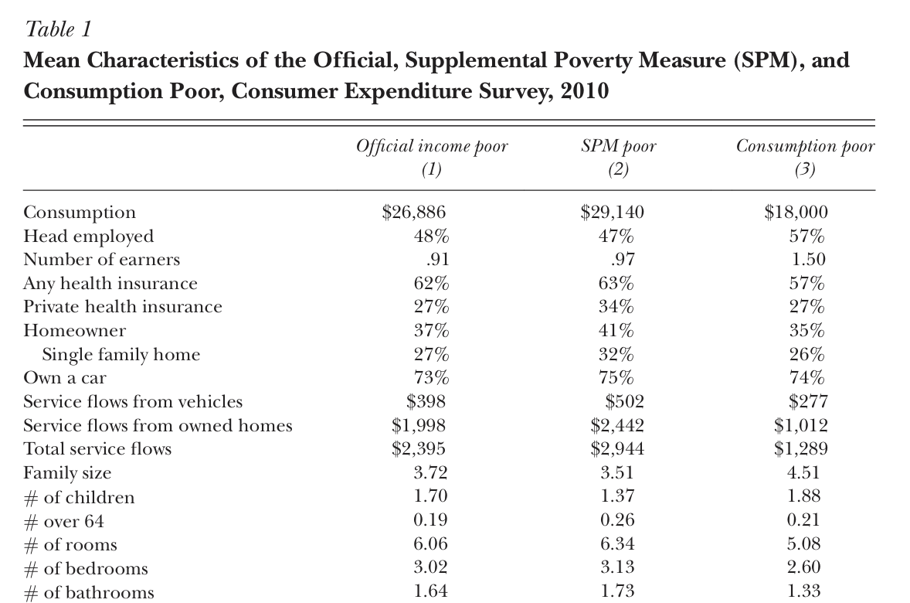
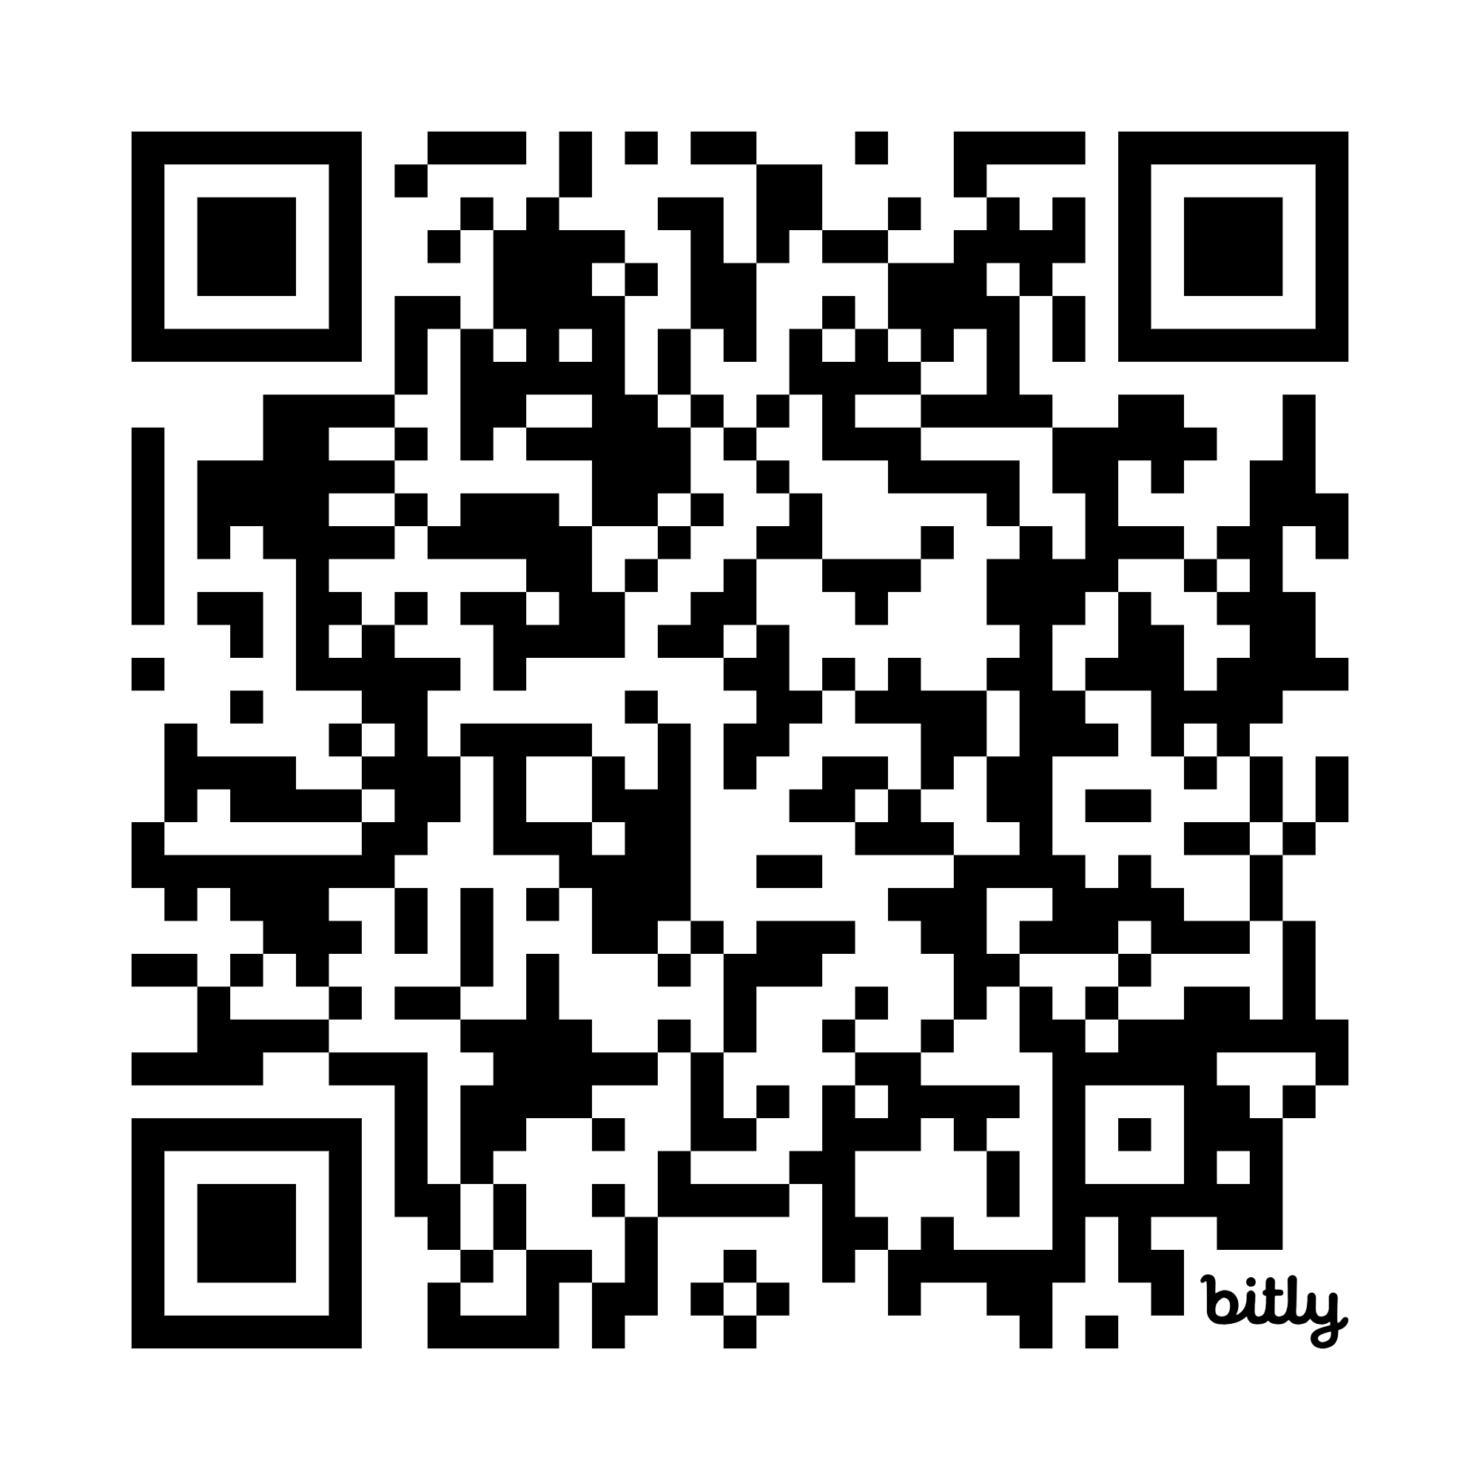
Who are identified as poor?
Use the same threshold to determine poverty, find the 16.5 percentile of the distribution.
View Table I from the paper.
Go to bit.ly/glbl3225_tables
Note what you find interesting.

Slide 22
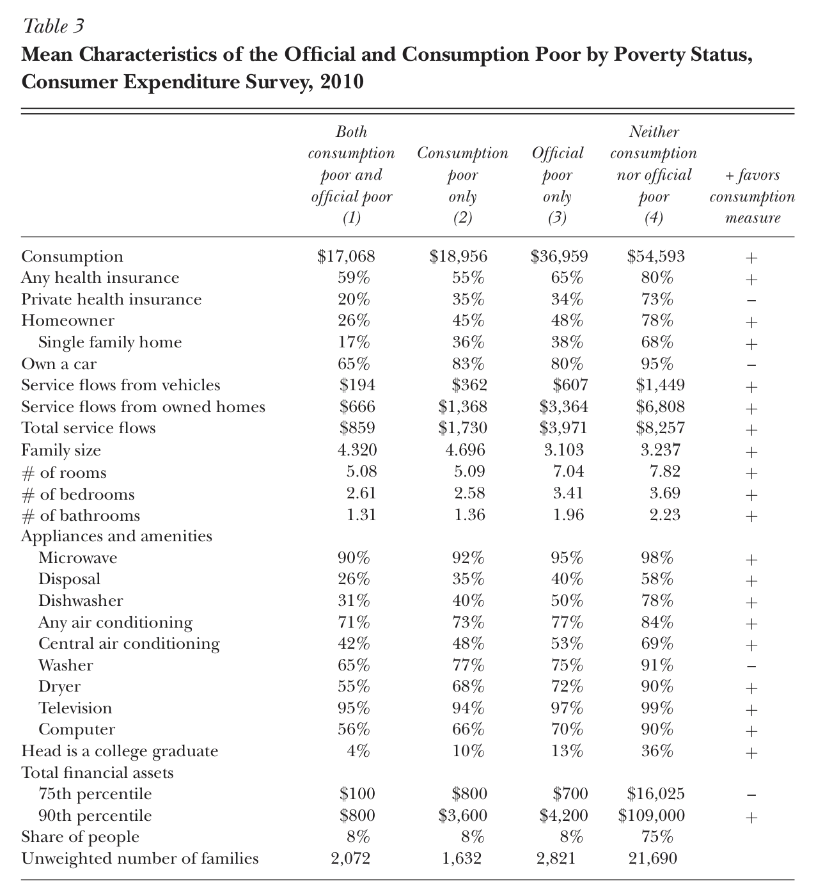
Who was added or removed?
Let’s examine Table 3
from the paper.
Go to bit.ly/glbl3225_tables

Slide 23
So which measure should we choose?
Depends on what one wants the measurement to capture.
There are theoretical vs practical consideration:
Consumption is much smoother than income.
Consumption captures savings, access to credit, other insurance, and transfers (public or private).
Disaggregating consumption data is more useful to understand welfare than disaggregating income.
Depending on what is measured, one might be easier to collect in the field than others.
Both are typically underreported, but more severe for income.
See Table B.1. from Mancini & Vecchi (2022) for other reasons.

Slide 24
Final Thoughts
Poverty measures are important tools to:
track development
identify individuals in need
target and allocate social programs.
They can have large implications for all development stakeholders.
Determining which poverty measure or threshold to use, however, is not easy.
In this lecture, we discuss many decisions that goes into deciding a poverty measure. It is important to know what an index measures and what it may miss.

Slide 25
References
De Janvry, A., & Sadoulet, E. (2022). Development economics: Theory and practice. 2nd Edition. Routledge.
Mancini, Giulia; Vecchi, Giovanni. On the Construction of a Consumption Aggregate for Inequality and Poverty Analysis (English). Washington, D.C. : World Bank.
Meyer, Bruce D., and James X. Sullivan. (2012). "Identifying the Disadvantaged: Official Poverty, Consumption Poverty, and the New Supplemental Poverty Measure." Journal of Economic Perspectives, 26 (3): 111–36.

